Slide 1

EXPLORATORY DATA ANALYSIS CAPSTONE PROJECT-01 EDA ON PLAY-STORE By: Nagendra Pratap Singh (Data Science Trainee, AlmaBetter)

Slide 2
Introduction :
Agenda
1.Reason for this project.
2.Problem Statement
3.Data Preparation
4.Analysis
5.Problem Faced
6.Conclusion
Smartphone applications are widely available. Apps are being produced at an increasing rate since they are simple to make and may be profitable.
More than 85% of all mobile devices currently run Google's OS, making Android the most popular mobile operating system. The biggest and most well-known Android software store is the Google Play Store.
On the Google Play Store, there are more than 3.04 million applications.
The data from Play Store applications has a great deal of potential to help app development companies succeed.

Slide 3




Reason To Analyse Google Play store :
We can observe that, whether we are aware of it or not, many applications are connecting us in our day-to-day lives. Mobile applications are widely used and are simple to create.
If analyzed properly, the Play Store app data has tremendous potential for the application development industry and may be very successful.
Mobile App Market is set to grow 20% by 2023
What are some interesting patterns in user behavior related to app usage & reviews
90% of all apps on mobile devices are Android apps.
Why is an app successful? Can we forecast its level of popularity?

Slide 4

Problem Statement
To , examine and analyze datasets are supplied, one with basic information and the other with user evaluations for the particular app and find all the essential aspects responsible for app engagement and success.
Our goal is to fully comprehend and inform everyone who wants to enter the Play store app industry.
What encourages individuals to download an application?
How are installs, pricing, ratings, reviews, and categories related to one another?

Slide 5
Analytics By
Nagendra Pratap Singh

Slide 6

Process
Data Understanding
Data Cleaning
Find Null values
Data Wrangling
Exploratory data analysis
Notes:
We must examine the issue in thoroughly and attempt to find solutions before we can draw a judgement.
The data is complicated and extremely intriguing due to the vast number of rows and columns.
We have been given access to two datasets so that you can see how much data we are dealing with.
The first is the Play Store data, which includes details on an app's category, rating, size, downloads, content rating, and a variety of other factors.
The second dataset is made up of review data, which includes translated reviews, attitudes, and many other things.

Slide 7
Process Flowchart:
Loading the data sets: Two datasets, First Play store app
dataset and User Reviews dataset.
Import Libraries: NumPy, Pandas, Seaborn and Matplotlib
Data cleaning: Null values, Finding and removing Outliers, Removing duplicate data.
Data Imputation: Filling the missing categorical values with mode and numerical values with median. Conversion of price, installs, reviews into numerical values.
Exploratory Data Analysis: Analyzing the data sets to summarize their main characteristics using statistical graphics and data visualizations method.

Slide 8
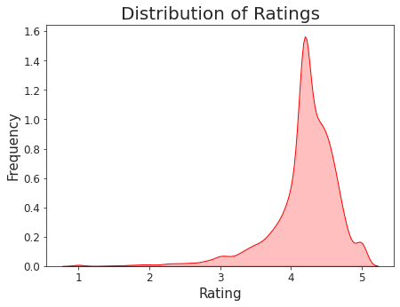
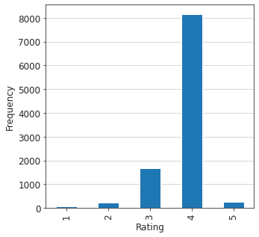
Observation-1 Average Rating

Slide 9
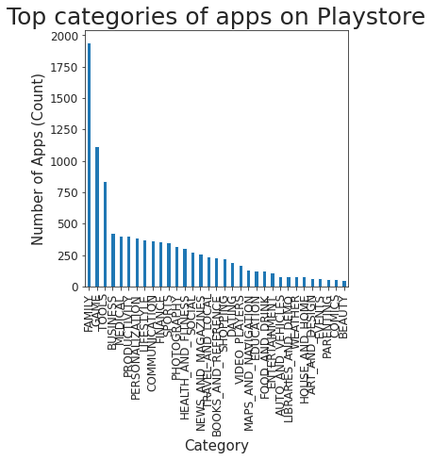
Observation-2

Slide 10
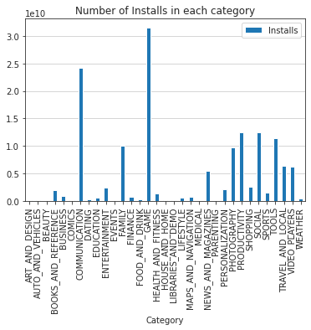
Observation-3

Slide 11
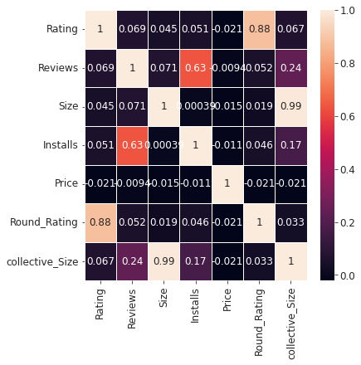
Observation-4

Slide 12
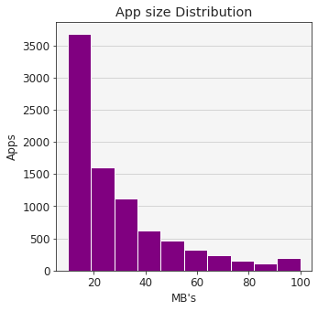
Observation-5

Slide 13
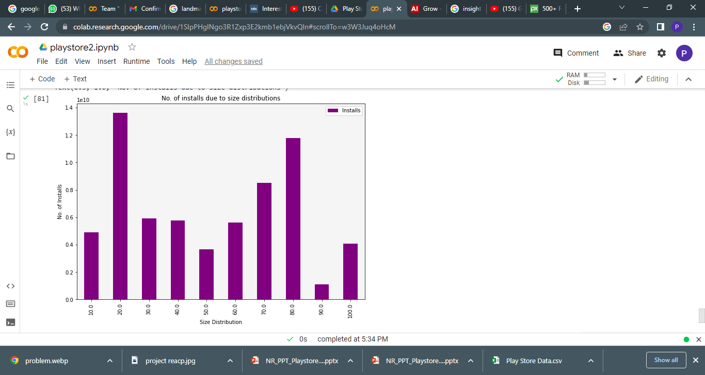
Observation-6

Slide 14
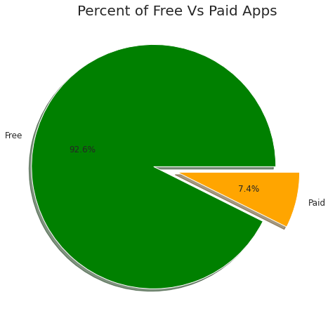
Observation-7
Major Type of app distribution in Play store.
Majority of app in the play store is free due to which it create major effect in installment or the review and rating.

Slide 15
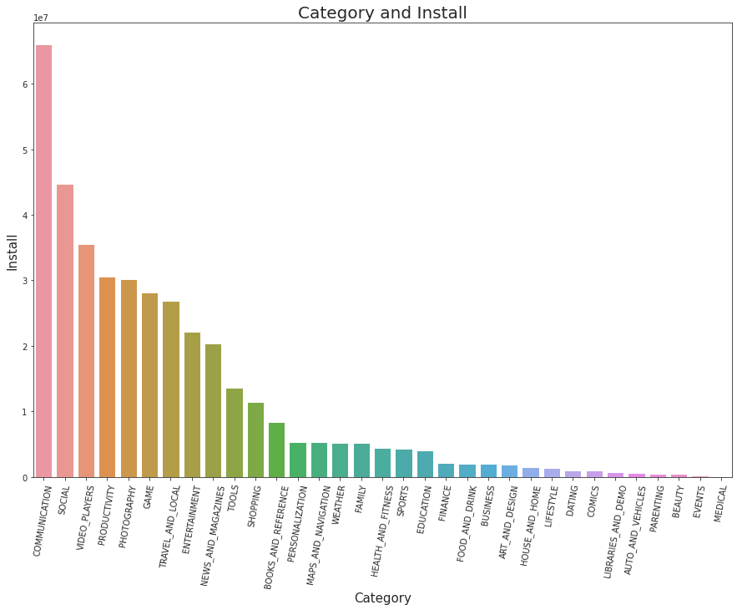
Observation-8
Distribution of apps in term of their category and install
Notes:
we can conclude that majority of the free apps are small in size and having high rating. While for paid apps, we have quite equal distribution in term on size and rating. so , free app and small size app create much more effect then others.

Slide 16
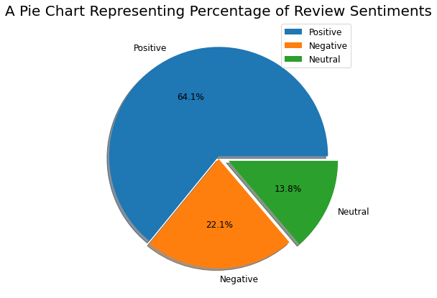
Observation-9
Review Sentiments:
As we can see it from the pie charts there are 64.1 % of Positive sentiments, 22.1% of Negative sentiments, and 13.8% neutral sentiments.

Slide 17
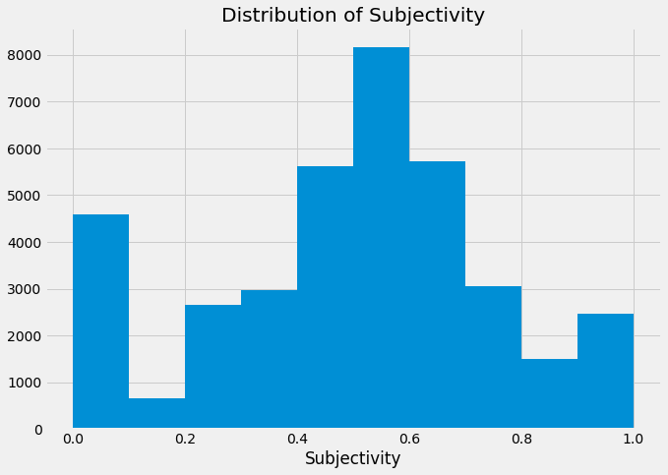
Observation-10
It is clear that between 0.4 and 0.7 is when sentiment subjectivity is at its highest. This leads us to the conclusion that the majority of the audience rates the applications in accordance with their personal experiences.

Slide 18
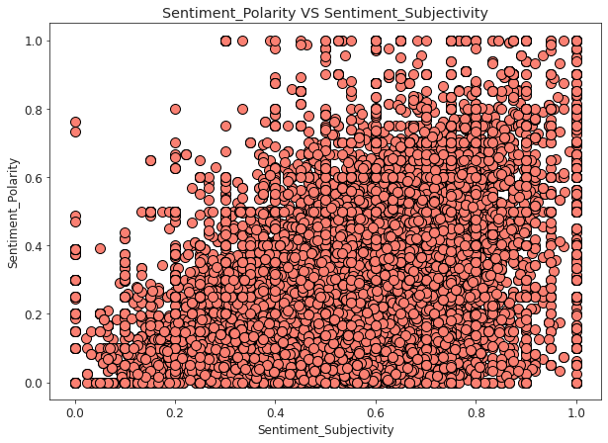
Observation-11
Does sentiments Polarity is proportional to sentiments subjectivity
From the aforementioned scatter plot, it can be inferred that, while not always proportional to sentiment polarity, sentiment subjectivity generally exhibits a proportionate pattern.

Slide 19

Problem – Faced
Understanding the issue statement and reading the dataset .
analyzing the business KPIs for app development and coming up with a fix.
handling the dataset's incorrect, duplicate, and Nan values.
creating a variety of representations to effectively explain the reader's conclusions and patterns while condensing the dataset's data.

Slide 20
Conclusion:
So, we may draw the conclusion that data cleansing is crucial for accuracy and results before beginning any form of exploration.
We can all see the many findings and inferences that come from data visualization, as well as how visualizations can make any graph, plot, chart, or map interesting.
Which simplify the data and can be easily understand the role of the data and their elements in the diverse world of play store.
According to the graph visualizations above, even though there are twice as few applications in these categories as there are in the category FAMILY, the majority of the trending apps (in terms of user installations) come from the categories of GAME, COMMUNICATION, and TOOL. These applications' popularity is largely owing to the fact that they may amuse or help the user by nature. Also, it demonstrates a positive trend in which we can observe that developers from these categories are placing more emphasis on the caliber than the number of the apps.
In addition to this, it can be noted that most applications have a larger number of user installations or positive reviews, with the majority of apps having ratings around 4. (8000 apps). Also, the app's size and cost make a small difference but do not significantly affect its positive ratings and reviews, even if they are high. Yet, we receive a bigger number of user installations and ratings as a result of the free in charges.
The figure also demonstrates the importance of feelings, with the highest percentage of positive sentiment (64.1%), which is found within subjectivity ranges of 0.4 and 0.7. This leads us to the conclusion that the majority of the audience rates the applications in accordance with their personal experiences.
As, we can see that, why exploring data is important before starting to build ML models
As a conclusion, we learnt that the current trends in the Android market are mostly from these categories which assisting, communicating or entertaining apps.

Slide 21


